Slide 1
Course: Data Mining Instructor: Dr. Atif Khan

Slide 2
What is Data Mining: Informal
There are things that we know that we know…
For example: your name, parents name
There are things that we know that we don’t know…
For example: Result of lottery, What you will eat after 2 days
There are things that we don’t know we don’t know.”
(Donald Rumsfield, US Secretary of Defence)
Notes:
Non technical person, nor a data mining guru
What is he thinking about me?
Prize as a result of lottery
There are things that we do not know, that we do not know about them.
Are they beneficial, if you know? Or it is harmful, not to know them? We can not say anything because we do not know.

Slide 3
What is Data Mining: Informal
Large quantity
Mine
Coal
Large quantity
Mine
Gold
Voluminous Data
Mine
Knowledge
Notes:
Gold mixed with stones and other stuff.
New things are discovered in data mining that you did not know before

Slide 4
What is Data Mining: Slightly Informal
Tell me something that I should know i.e. query your Database, data repository, that tell me something that I don’t know, or I should know. (Can’t write SQL)
Data mining is an exploratory approach.
Browsing data using data mining techniques may reveal something that might be of interest to the user as information that was unknown previously.
Hence, in data mining we don’t know the results.
Notes:
I do not know what to ask from database, then I can not formalize such query to get results.
exploring the data reveals other interesting features. Histogram or scatter plot of data
Analysis task is to find the variables which best predict the tip that a dining party will give to the waiter.^{[11]} The variables available in the data collected for this task are: the tip amount, total bill, payer gender, smoking/non-smoking section, time of day, day of the week, and size of the party.

Slide 5
Dm is finding in the hay stack (huge data) the needle (knowledge).
You don’t have idea about where the needle can be found or even you don’t know whether the needle is there in the haystack or not.

Slide 6
What is Data Mining: Formal
Historically, the notion of finding useful patterns in data has been given a variety of names, including data mining, knowledge extraction, information discovery, information harvesting, data archaeology, and data pattern processing.
The term data mining has mostly been used by statisticians, data analysts, and management information systems (MIS) communities.
It has also gained popularity in the database field.

Slide 7
What is Data Mining: Formal
KDD refers to the overall process of discovering useful knowledge from data, and data mining refers to a particular step in this process.
Data mining is the application of specific algorithms for extracting patterns from data.
Data mining digs out valuable non-trivial information from large multidimensional apparently unrelated data bases (sets).
Notes:
Trivial information: sawayya+milk+sugar+dates are sold out altegether during Eid, this is common
Non-trivial: Winter season---no Eid--- sales of some items booted suddenly..
Data attributes/columns:50or 100, records in db are not related. DM tool extracts valuable information
Knowledge finding: query the database for something that you know
Knowledge discovery: query the database for something that you do not know

Slide 8
Nontrivial
By nontrivial, we mean that some search or inference is involved; that is, it is not simple like computing the average value of a set of numbers.
If “Suwaiyan” sale increases during Eid days, the sugar, milk and date sales also increase (trivial info).
If the sale of some items boosts up in normal days, in some region of the country, this is non-trivial information
Value
The term value refers to the importance of discovered hidden patterns to the user in terms of its usability, validity, benefit and understandability.

Slide 9
In a flat or relational database, each field in a record represents a dimension.
In a multidimensional database, a dimension is a set of similar entities; for example, a multidimensional sales database might include the dimensions Product, Time, and City.
Data mining multidimensional databases allows users to analyze data from many different dimensions or angles.

Slide 10
Unrelated
Humans often lack the ability to comprehend and manage the immense amount of available and unrelated data.
Data mining can help us take very small pieces of data that have no relationship (unrelated) .
It determines whether those pieces are correlated and can tell us anything that we need to know”.

Slide 11
Data mining (DM) inter disciplinary approach and it is the integration of business knowledge, people, information theory, databases, algorithms, statistics , artificial intelligence and mathematics.
Data mining consists of algorithms for extracting useful hidden patterns from huge data.
Commonly used DM algorithms classification algorithms, clustering algorithms, rule based algorithms, and artificial neural networks etc.
Notes:
Human involvement in the data mining process is crucial in sense that value of patterns is well
known to the user.

Slide 12
Why Data Mining
The data volumes of organizations/enterprises/businesses are increasing with a greater pace e.g. NASA Earth Observing System (EOS) generates more than 100 gigabytes of image data per hour, stored in eight centers.
Data collected much faster than it can be processed or managed.
NASA EOS will alone, collect 15 Peta bytes by 2007 (15,000,000,000,000,000 bytes).
So majority of the data will remain untouched, unseen, unused thus limiting the discovery of useful patterns.
Notes:
Usefulness of data decreases when its size increases.

Slide 13
Why Data Mining
This requires the availability of tools and techniques that can accommodate the huge volumes of data.
Obviously, data mining is the best solution.
It works by reducing the data volume and/or raise the information content of user interest by structuring, querying, filtering, summarizing, aggregating, mining etc.
Claude Shannon’s theory states that as the volume increases the information content decreases and vice versa.
Notes:
By raising information content means that the those patterns are built and brought to surface that are
otherwise hidden and scattered in the data sea and of user interest.

Slide 14
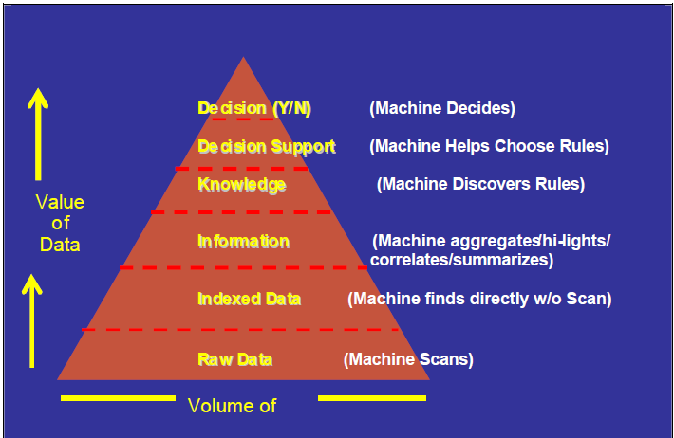
Claude Shannon’s theory
Notes:
Example sugarcane juiuce, ghur..sugar
Here exploring data for useful information needs conventional data scanning, thus one is lost in the deep blue sea, reaching no-where.
Data indexing has greatly reduced the data volume as compared to the data in the lower level (raw data). Now we have found short cuts, to reach
desired points in the voluminous data sea, rather than conventional scanning. The data has more value than the data at lower level.
In the next level is the aggregate/summarized data. Here the data is in a form that can readily be used as information. Thus much compact volume and greater data value than the previous lower levels.
Next is the level where the machine discovers and learns rules. The rules can easily be applied to extract only desired data, or knowledge base thus greatly reducing the data volume as compared to other lower levels.
machine supports decision making process by helping in selecting appropriate pre defined rules. Here data volume is minimal and similarly higher data value than the lower levels.
machine itself makes decisions based on predefined rules. Those most appropriate rules are selected by machine itself for making a decision. Here of course
the data volume is minimum and the value of data is thus maximum.

Slide 15
Why Data Mining: Supply & Demand
The amount of digital data recorded in different organizations world wide has greatly increased in the past few decades.
However, the number of scientists, engineers and analysts for data analysis has not grown accordingly to analyze, explore and extract knowledge from massive data.
That is supply of desired scientists and researchers don’t meet their high demand in high numbers.
Thus data mining tools provide a way, enabling limited scientists and researchers to analyze huge amounts of data.

Slide 16
Besides relational database data, data warehouse data, and transaction data, there are many other kinds of data that have versatile forms and structures and rather different semantic meanings.
Such kinds of data can be seen in many applications:
time-related or sequence data (e.g., historical records, stock exchange data, and time-series and biological sequence data),
data streams (e.g., video surveillance and sensor data, which are continuously transmitted),
spatial data (e.g., maps),
engineering design data (e.g., the design of buildings, system components, or integrated circuits),
hypertext and multimedia data (including text, image, video, and audio data), graph and networked data (e.g., social and information networks),
and the Web (a huge, widely distributed information repository made available by the Internet). These applications bring about new challenges, like how to handle data carrying special structures (e.g., sequences, trees, graphs, and networks)

Slide 17
Why Data Mining?: Bridging the gap
Data mining filled the gap between supply and demand through algorithms.
Develop algorithms and systems to mine large, massive and high dimensional data sets.
Develop algorithms and systems to mine new types of data (images, music, videos).
Develop algorithms, and techniques to mine distributed data(data recorded in distributed locations).
Need to develop DM tools and techniques to improve the already used data mining systems.
Notes:
Data mining filled the gap between supply and demand through algorithms. How?
Algorithms to mine or to extract knowledge from high dimensional data sets.
DM is not about to mine/extract knowledge form transactional/operational databases.
In DM, we use Algorithms to mine diverse data sets(new data type) i.e. to mine (extract knowledge) from videos, music/sound clips, images

Slide 18
Data Mining is HOT
The TIME Magazine May 2000 issue has given a list of the ten hottest jobs of year 2025.
Data miners and knowledge engineers were at 5th and 6th position respectively.
Similarly, MIT's Technology Review has identified 10 emerging areas of technology that will soon have a profound impact on the economy and how we live and work.
Among the list of emerging technologies that will change the world, Data mining is at the 3rd place.
Notes:
Thus in view of the above facts, data miners have a long career in national as well as
international market as major companies both private and government are quickly adopting the
technology and many have already adopted.

Slide 19
Data Mining at the Top Layer
Conventional data processing systems or online transaction processing systems (OLTP) lie at the bottom level.
These systems have well defined queries and no any sort of knowledge discovery is performed.
OLTP systems are meant to support day to day transactions and do not support decision making in any way(sales,invoice).
Data Mining provides a global macroscopic view or aerial view of your data.

Slide 20
Conventional data processing systems—DWH—Data Minig.
Data mining is at the top in terms of complexity of questions which can not be asked because these questions are not known in advance.
Before applying mining algorithms data must be brought in a form so that the knowledge exploration from huge, heterogeneous and multi source data can efficiently and effectively be performed.
Thus DWH is the process of bringing input data in a form that can readily be used by data mining techniques to find hidden patterns.

Slide 21
What Can Data Mining Do
Classification is one of the DM technique.
In classification, different groups/classes are made based on properties of existing data.
When new observation is presented, its properties are examined and assigning it to a predefined class.
A student can be grouped either as good or bad depending on his previous record.
Similarly an employee can be grouped as excellent, good, fair etc based on his track record in the organization.
Notes:
If a student has good grade(feature) in metric, fsc and good gpa in BS, then we predit that the student is good otherwise bad.
So how students or employees were classified? Answer is using the historical data.
Yes history is the best predictor of the future.
When an organization conducts test and interviews from candidate employees, their performance is compared with those of the existing employees. The knowledge can be used to predict how good you can perform if employed.

Slide 22
Classification
So how students or employees were classified? Answer is using the historical data.
Thus, history is the best predictor of the future.
An example where classification can prove to be beneficial is in customer segmentation.
The businesses can classify their customers as either good or bad;
The knowledge thus can be utilized for executing targeted marketing plans.
Notes:
Another example is of a news site, where there are number of visitors and also many content developers.
Now where to place a specific news item on the web site? What should be the hierarchical position of the news item, what should be the news chapter, category?
Either it should be in the sports or weather section and so on. What is the problem in doing all this? The problem is that it’s not a matter of
placing a single news item. The site as already mentioned contains a number of content developers and also many categories. If sorting is performed humanly, then it is time consuming. That is why classification techniques can scan and process the document to decide its category or class.

Slide 23
Classification is a prediction problem that predicts the categorical class labels which are discrete and unordered.
[
It is a two-step process, consisting of a learning step and a classification step.

Slide 24
Classification
Following are the examples of cases where the data analysis task is Classification −
A bank loan officer wants to analyze the data in order to know which customer (loan applicant) are risky or which are safe.
A marketing manager at a company needs to analyze a customer with a given profile, who will buy a new computer.
A medical researcher wants to analyze cancer data in order to predict which one of the two specific treatments a patient should receive.
In above examples, a model or classifier is constructed to predict the categorical labels.
These labels are risky or safe for loan application data, yes or no for marketing data, Treatment A or Treatment B for cancer data

Slide 25
How Does Classification Works?
The Data Classification process includes two steps −
Building the Classifier or Model
Using Classifier for Classification
Building the Classifier or Model
This step is the learning step or the learning phase.
In this step the classification algorithms build the classifier.
The classifier is built from the training set made up of database tuples and their associated class labels.
Each tuple that constitutes the training set is referred to as a category or class. These tuples can also be referred to as sample, object or data points.

Slide 26
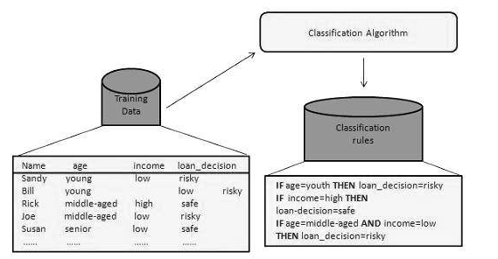
How Does Classification Works?
The Supervised Learning algorithm will learn the relation between training examples and their associated target variables and apply that learned relationship to classify entirely new inputs (without targets).

Slide 27
How Does Classification Works?
Using Classifier for Classification
In this step, the classifier is used for classification.
Here the test data is used to estimate the accuracy of classification rules.
The classification rules can be applied to the new data tuples if the accuracy is considered acceptable.

Slide 28
Classification
Classification is the process of finding a model (or function) that describes and distinguishes data classes or concepts.
The model is derived based on the analysis of a set of
training data (i.e., data objects for which the class labels are
known).
The model is used to predict the class label of objects for which the class label is unknown.
“How is the derived classification model presented?”

Slide 29
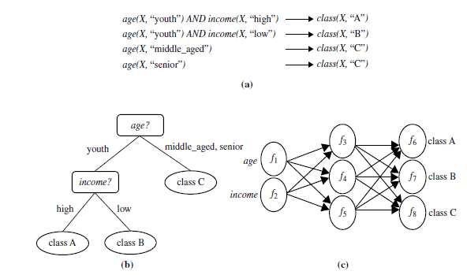
The derived model may be represented in various forms, such as classification rules (i.e., IF-THEN rules), decision trees, mathematical formulae, or neural networks

Slide 30
Examples of Classification Problems
the goal is to categorize objects into a fixed set of categories.
Face detection: Identify faces in images (or indicate if a face is present).
Email filtering: Classify emails into spam and not-spam.
Medical diagnosis: Diagnose a patient as a sufferer or non-sufferer of some disease.
Weather prediction: Predict, for instance, whether or not it will rain tomorrow

Slide 31
Prediction
Prediction models continuous valued functions.
Like Classification, training set is used to build the model (predictor).
However, for accuracy, an independent test set is used.
Accuracy of predictor: error= Predicted Value – Actual Value (for each of the test tuples)
Suppose the marketing manager needs to predict how much a given customer will spend during a sale at his company.
In this example we are bothered to predict a numeric value.
Notes:
Customer will spend to buy products of company

Slide 32
Prediction
Therefore the data analysis task is an example of numeric prediction.
In this case, a model or a predictor will be constructed that predicts a continuous-valued-function or ordered value.
Note − Regression analysis is a statistical methodology that is most often used for numeric prediction.
Suppose a business wants to know about their customers their propensity to buy/spend/purchase.
In other words, how much the customer will spend in next 6 months?
Notes:
Propensity means tendency/inclination

Slide 33
Prediction
Similarly a mobile phone company can install a new tower based on the knowledge spending habits of its customers in the surroundings.
It is not the case that companies install facilities or invest money because of their gut feelings.
Why companies should bother about their customers?
Because if they know their customers, their interests, their like and dislikes, their buying patterns
Then it is possible to run targeted marketing campaigns and thus increasing profit.

Slide 34
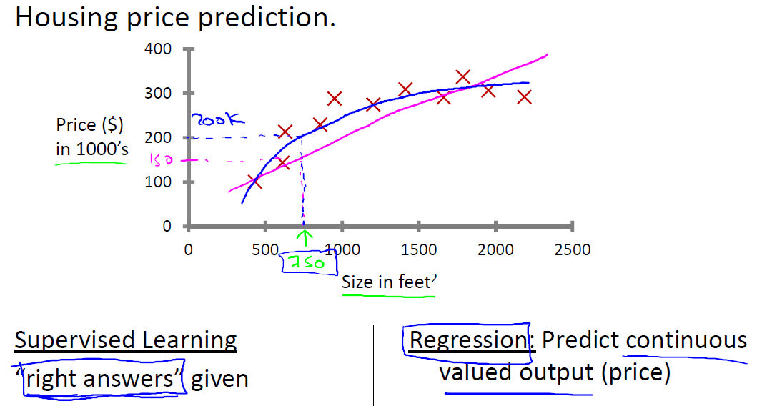

Slide 35

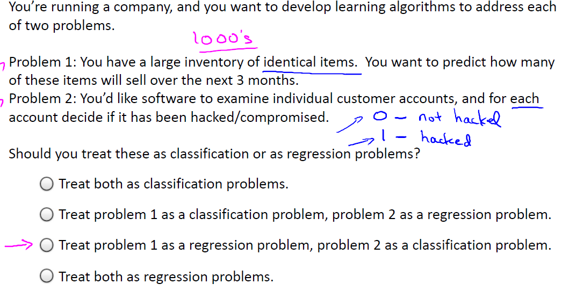

Slide 36
Based on the given datasets the machine learning problem is categorized into two types, Classification, and Regression.
If the given data has both input (training) values and output (target) values, then it is a Classification problem.
If the dataset has continuous numerical values of attributes without any target labels, then it comes under Regression problem.

Slide 37
Market Basket Analysis
Next problem that can be solved by DM is the market basket analysis.
Determining which things go together, e.g. items in a shopping cart at a super market.
Why the knowledge is needed for decision making?
This can be beneficial because if we know that some type of customers mostly buy item X too when they buy item Y and so on.
Then we can run corresponding sale promotional schemes.

Slide 38
Market Basket Analysis
This can be useful for inventory management i.e. you may place things that are bought together in close proximity,
You can place those things close in your store so that it’s easy to bring things together when needed.
Identify cross selling opportunities.
Another benefit is that u can bundle or package items together so as to boost the sales of underselling items.
Customer satisfaction is critical for businesses,
Notes:
Encouraging a customer who buys a product (gasoline, for example) to buy a related or complementary product (engine oil, for example). Cross-selling is generally illegal if there is a tie-in between the two products; where the customer must buy one in order to buy the other. Read more: http://www.businessdictionary.com/definition/cross-selling.html

Slide 39
Market Basket Analysis
Another benefit of market basket analysis is the customer facilitation.
Thus, by placing together the associated items you facilitate the customer making easy access to the desired items.
Otherwise he may run here and there for searching the item.

Slide 40
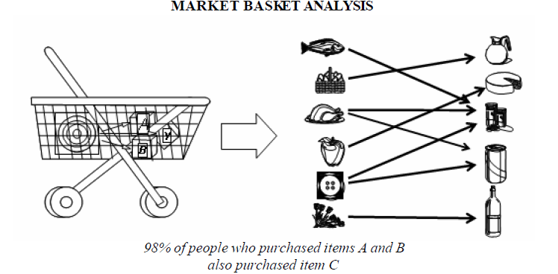
Market Basket Analysis

Slide 41
Discovering Association Rules
Discovering Association Rules is another name given to market basket analysis.
Here rules are formed from the dependencies among data items which can be used to predict the occurrence of an item based on others
e.g. suppose hardware shop where whenever a customer buys tin color, it is more likely that he /she will buy painting brushes too.
So based on the occurrence or event of paint purchase, we can predict the occurrence of item paint brush.

Slide 42
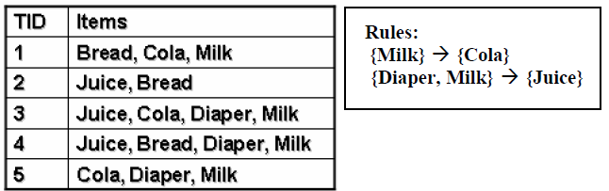
Discovering Association Rules
What is the unknown unknown?
The discovery is that the sale of juice with diapers and milk is non trivial. This can never be guessed because no obvious association is found among the items.

Slide 43
For example, the information that customers who purchase computers also tend to buy financial management software at the same time is represented in association Rule
Rule support and confidence are two measures of rule interestingness, reflecting the usefulness and certainty of discovered rules respectively.
A support of 2% for association Rule means that 2% of all the transactions under analysis show that computer and financial management software are purchased together.

Slide 44
Discovering Association Rules
A confidence of 60% means that 60% of the customers who purchased a computer also bought the software.
Typically, association rules are considered interesting if they satisfy both a minimum support threshold and a minimum confidence threshold.
Such thresholds can be set by users or domain experts.

Slide 45
Applications of Data Mining
Financial data analysis
Retail Industry
Telecommunication Industry
Biological Data Analysis
Other Scientific Applications
Credit risk prediction
Medical diagnosis
Insurance Companies

Slide 46
Market Analysis and Management
Listed below are the various fields of market where data mining is used −
Customer Profiling − Data mining helps determine what kind of people buy what kind of products.
Identifying Customer Requirements − Data mining helps in identifying the best products for different customers. It uses prediction to find the factors that may attract new customers.
Cross Market Analysis − Data mining performs association/correlations between product sales.
Notes:
Go to your local bookstore, book fair, and/or Amazon.com and see what books from small presses might complement yours. Contact the author or publisher (check your PMA Directory, Books in Print, the BEA catalog or your favorite search engine for contact information) and see what potential partners are doing that might work well for both of you to promote each others products.

Slide 47
Target Marketing − Data mining helps to find clusters of model customers who share the same characteristics such as interests, spending habits, income, etc.
Determining Customer purchasing pattern − Data mining helps in determining customer purchasing pattern.
Providing Summary Information − Data mining provides us various multidimensional summary reports.

Slide 48
Fraud detection
By observing data usage patterns.
People have typical purchase patterns.
Deviation from patterns.
Certain cities notorious for fraud.
Certain items bought by stolen cards
In fraud telephone calls, it helps to find
the destination of the call,
duration of the call,
time of the day or week, etc.
It also analyzes the patterns that deviate from expected norms.
Notes:
Credit card company—customer- aeroplane tickets, hotel reservations,rent cars- using credit card
Shoppings on weekends– specific stores-clothes and sports good
Suddenly patterns of buying behavior cds, tv , steroreos, other electronics, transactions in karachi, high probability of fraud
Call patterns limited to peshawar. Then suddenly to lahore, karachi or even abroad

Slide 49
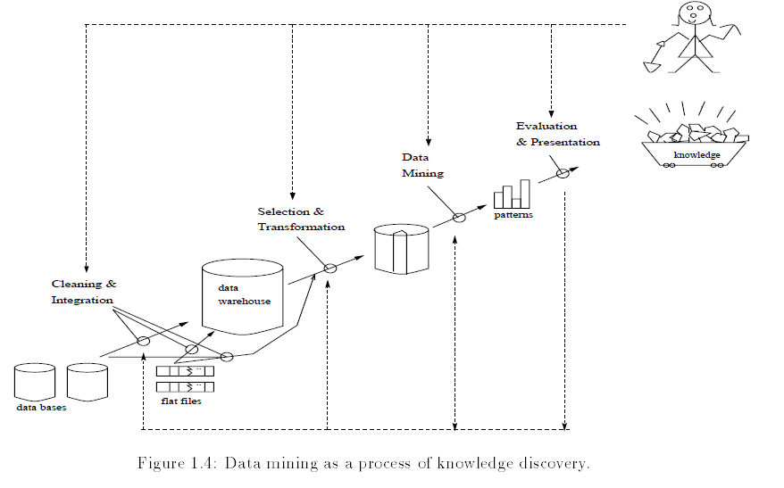

Slide 50
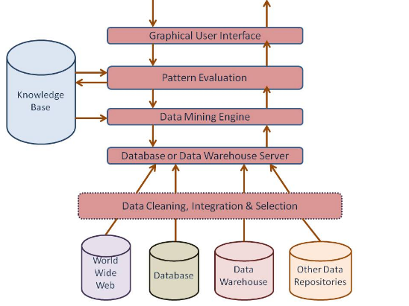
Architecture of Data Mining System

Slide 51
Present an example where data mining is crucial to the success of a business. What data mining functions does this business need? Can they be performed alternatively by data query processing or simple statistical analysis?
A department store, for example, can use data mining to assist with its target marketing mail campaign.
Using data mining functions such as association, the store can use the mined strong association rules to determine which products bought by one group of customers are likely to lead to the buying of certain other products.
With this information, the store can then mail marketing materials only to those kinds of customers who exhibit a high likelihood of purchasing additional products.

Slide 52
Data query processing is used for data or information retrieval and does not have the means for finding association rules.
Similarly, simple statistical analysis cannot handle large amounts of data such as those of customer records in a department store.

Slide 53
Data warehouse VS Database:
A data warehouse is a repository of information collected from multiple sources, over a history of time, stored under a unified schema, and used for data analysis and decision support.
A database, is a collection of interrelated data that represents the current status of the stored data.
Both are repositories of information, storing huge amounts of persistent data

